Slide 1
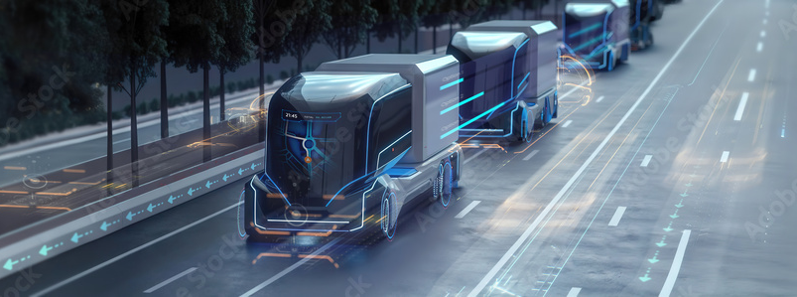
Truck Platooning & SVM Implementation
By Group (B):
Mohamed Abdo
Arrya
Mustafa Qaiser

Slide 2
Motivation

Slide 3
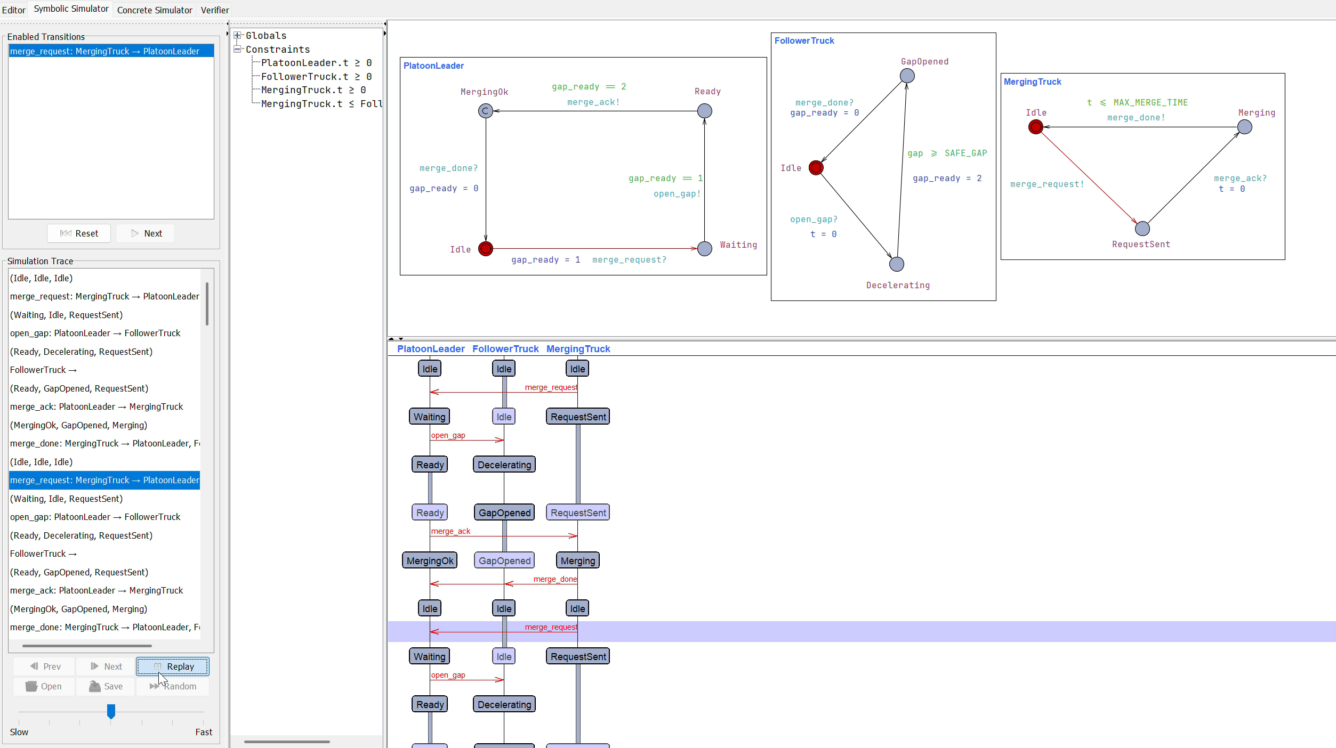
Scenario(1)

Slide 4
Scenario(2)

Slide 5
Scenario(3)

Slide 6
All Scenarios In one

Slide 7
Live UPPAAL

Slide 8
Carla Dataset Filtering
Open CV

Slide 9
Classes & SVM Training

Slide 10
Evaluation & Prediction

Slide 11
CARLA simulation Implementation

Slide 12
Challenges

Slide 13
Future Directions

Slide 14
Conclusion

Slide 15
References:
[1]: Stock-Illustration „futuristic trucks fleet on highway with full self driving system activated for transportation autonomy concepts as wide banner with copy space area - Generative AI“ | Adobe Stock

